Slide 1
Unsupervised Learning

Slide 2
Content
🞄 Introduction
🞄 Applications
🞄 Types of clustering
🞄 Clustering criterion functions
🞄 Distance functions
🞄 Normalization
🞄 Which clustering algorithm to use?
🞄 Cluster evaluation
🞄 Summary

Slide 3
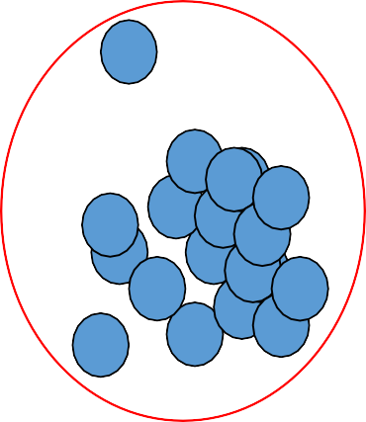
Motivation
🞄 The goal of clustering is to
🞄 group data points that are close (or similar) to each other
🞄 identify such groupings (or clusters) in an unsupervised manner

Slide 4
Introduction
🞄 Supervised learning: discover patterns in the data with known target (class) or label.
🞄 These patterns are then utilized to predict the values of the target attribute in future data instances.
🞄 Unsupervised learning: The data have no target attribute.
🞄 We want to explore the data to find some intrinsic structures in them.

Slide 5

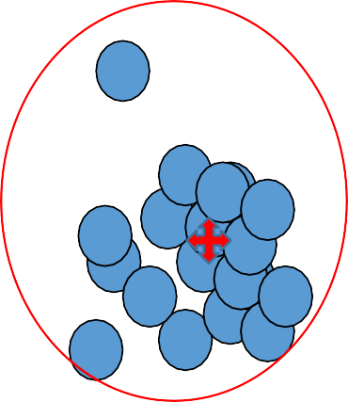
Cluster
🞄 A cluster is represented by a single point, known as centroid (or cluster center) of the cluster.
🞄 Centroid is computed as the mean of all data points in a cluster
𝐶_{𝑗} = ∑ 𝑥_{𝑖}
🞄 Cluster boundary is decided by the farthest data point in the cluster.

Slide 6
Applications
🞄 Example 1: groups people of similar sizes together to make “small”, “medium” and “large” T-Shirts.
🞄 Tailor-made for each person: too expensive
🞄 One-size-fits-all: does not fit all.
🞄 Example 2: In marketing, segment customers according to their similarities
🞄 To do targeted marketing.
🞄 Example 3: Given a collection of text documents, we want to organize them according to their content similarities,
🞄 To produce a topic hierarchy

Slide 7
Content
🞄 Motivation
🞄 Introduction
🞄 Applications
🞄 Types of clustering
🞄 Clustering criterion functions
🞄 Distance functions
🞄 Normalization
🞄 Which clustering algorithm to use?
🞄 Cluster evaluation
🞄 Summary

Slide 8
Types of clustering
🞄 Clustering: Task of grouping a set of data points such that data points in the same group are more similar to each other than data points in another group (group is known as cluster)
🞄 it groups data instances that are similar to (near) each other in one cluster and data
instances that are very different (far away) from each other into different clusters.
Types:
Exclusive Clustering: K-means
Overlapping Clustering: Fuzzy C-means
Hierarchical Clustering: Agglomerative clustering, divisive clustering
Probabilistic Clustering: Mixture of Gaussian models

Slide 9
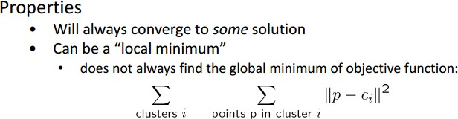
1. Exclusive clustering: K-means
🞄 Basic idea: randomly initialize the k cluster centers, and iterate between the two
steps we just saw.
Randomly initialize the cluster centers, c₁, ..., c_{K}
Given cluster centers, determine points in each cluster
🞄 For each point p, find the closest c_{i}. Put p into cluster i
Given points in each cluster, solve for c_{i}
🞄 Set c_{i} to be the mean of points in cluster i
If c_{i} have changed, repeat Step 2

Slide 10
K-means contd..
🞄 Algorithm
Begin
initialize n, c, μ₁, μ₂, …, μ_{c}(randomly do classify n samples according to
nearest μ_{i}
recompute μ_{i}
until no change in μ_{i}
return μ₁, μ₂, …, μ_{c}
End
selected)

Slide 11
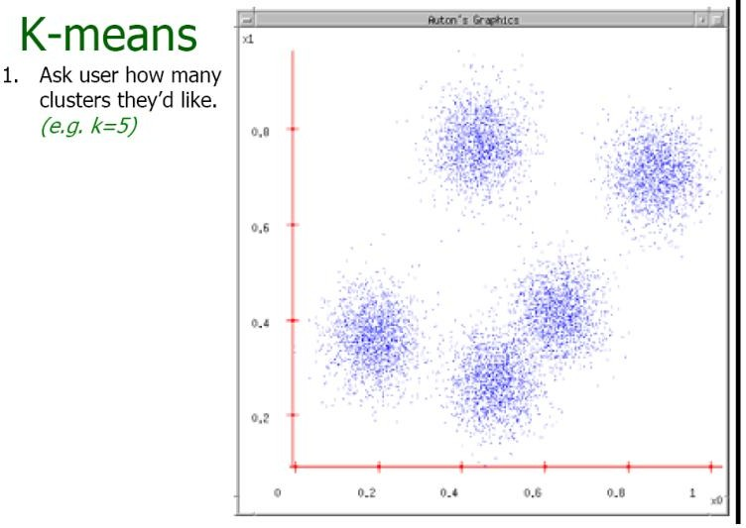
K-means example

Slide 12
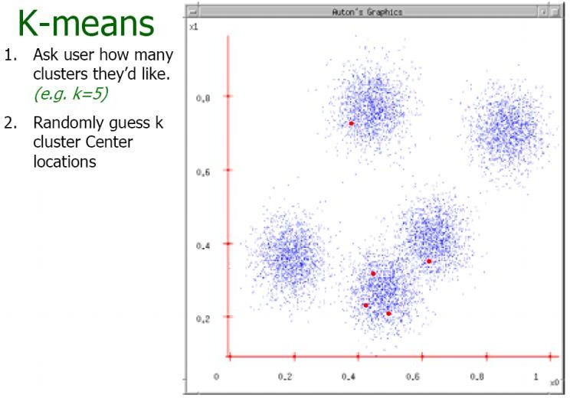
Example contd..

Slide 13
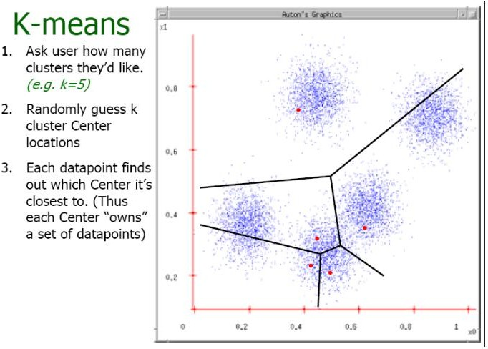
Example contd..

Slide 14
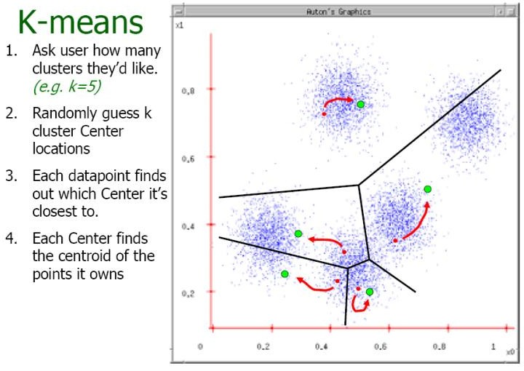
Example contd..

Slide 15
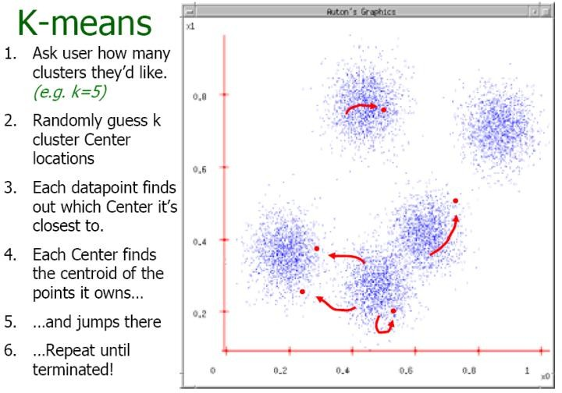
Example contd..

Slide 16
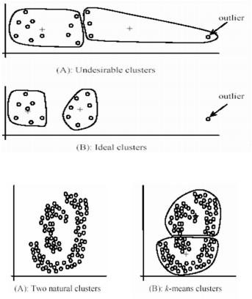
Contd..
🞄 Pros
🞄 Simple, fast to compute
🞄 Converges to local minimum of within-cluster squared error
🞄 Cons
🞄 Setting k?
🞄 Sensitive to initial centers
🞄 Sensitive to outliers
🞄 Detects spherical clusters
🞄 Assuming means can be computed

Slide 17

2. Fuzzy C-Means Clustering
🞄 One data point may belong to two or more cluster with different memberships.
🞄 Objective function:
where 1 ≤ m< ∞
🞄 An extension of k-means

Slide 18
Fuzzy c-means algorithm
🞄 Let x_{i} be a vector of values for data point g_{i}.
Initialize membership U⁽⁰⁾ = [ u_{ij} ] for data point g_{i} of cluster cl_{j} by random
At the k-th step, compute the fuzzy centroid C^{(k)} = [ c_{j} ] for j = 1, ..,
nc, where nc is the number of clusters, using
∑(u_{ij} )^{m} x_{i}
n
_{c j =} i=1
n
∑(u_{ij} )^{m} i=1
where m is the fuzzy parameter and n is the number of data points.

Slide 19
Fuzzy c-means algorithm
3. Update the fuzzy membership U^{(k)} = [ u_{ij} ], using
1
⎛
1
⎞ (m−1)
⎜ ⎟
⎜ _{xi} ⎟
c _{j}
u =
⎝ ⎠
ij
1
n_{c} ⎛
⎞ (m−1)
∑⎜ ⎟
1
⎜ _{x}
j =1 i
c _{j}
⎟
⎝ ⎠
If ||U^{(k)} – U^{(k-1)}|| < ε, then STOP, else return to step 2.
Determine membership cutoff
🞄 For each data point g_{i}, assign g_{i} to cluster cl_{j} if u_{ij} of U^{(k)} > α

Slide 20
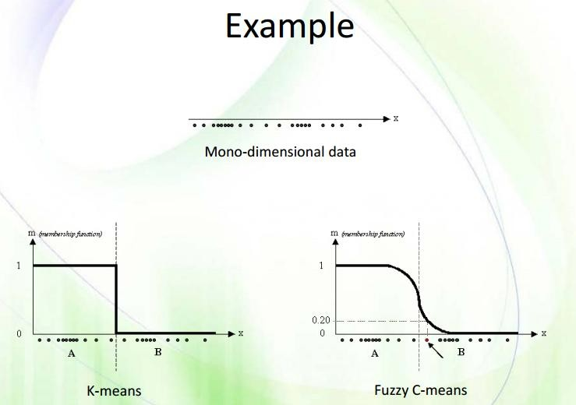
Example

Slide 21
Fuzzy c-means
🞄 Pros:
🞄 Allows a data point to be in multiple clusters
🞄 A more natural representation of the behavior of genes
🞄 genes usually are involved in multiple functions
🞄 Cons:
🞄 Need to define c (k in K-means), the number of clusters
🞄 Need to determine membership cutoff value
🞄 Clusters are sensitive to initial assignment of centroids
🞄 Fuzzy c-means is not a deterministic algorithm

Slide 22
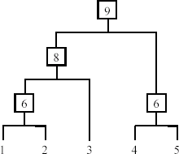
3. Hierarchical Clustering
🞄 Produce a nested sequence of clusters, a tree, also called Dendrogram.

Slide 23
Types of hierarchical clustering
🞄 Agglomerative (bottom up) clustering: It builds the dendrogram (tree) from the bottom level, and
🞄 merges the most similar (or nearest) pair of clusters
🞄 stops when all the data points are merged into a single cluster (i.e., the
root cluster).
🞄 Divisive (top down) clustering: It starts with all data points in one cluster, the root.
🞄 Splits the root into a set of child clusters. Each child cluster is recursively divided further
🞄 stops when only singleton clusters of individual data points remain, i.e.,
each cluster with only a single point
23

Slide 24
Agglomerative clustering
It is more popular then divisive methods.
🞄 At the beginning, each data point forms a cluster (also called a node).
🞄 Merge nodes/clusters that have the least distance.
🞄 Go on merging
🞄 Eventually all nodes belong to one cluster
24

Slide 25
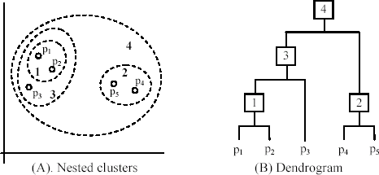
An example: working of the algorithm
25

Slide 26
Hierarchical clustering
🞄 Pros
🞄 Dendograms are great for visualization
🞄 Provides hierarchical relations between clusters
🞄 Shown to be able to capture concentric clusters
🞄 Cons
🞄 Not easy to define levels for clusters
🞄 Experiments showed that other clustering techniques outperform
hierarchical clustering

Slide 27
4. Probabilistic clustering
🞄 Gaussian mixture models

Slide 28
Content
🞄 Motivation
🞄 Introduction
🞄 Applications
🞄 Types of clustering
🞄 Clustering criterion functions
🞄 Distance functions
🞄 Data standardization
🞄 Which clustering algorithm to use?
🞄 Cluster evaluation
🞄 Summary

Slide 29
Clustering criterion ..
Similarity function
Stopping criterion
Cluster Quality

Slide 30
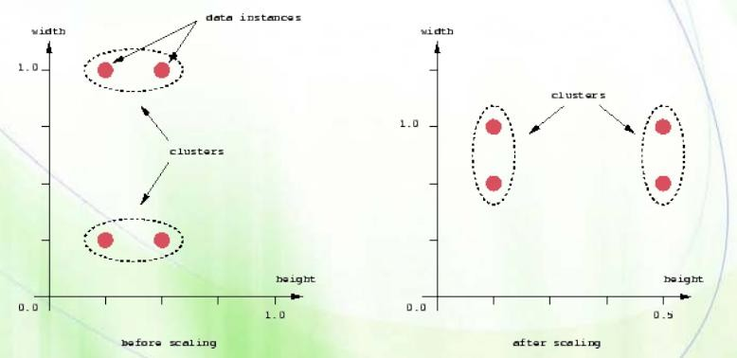
1. Similarity function / Distance measure
🞄 How to find distance b/w data points
🞄 Euclidean distance:
🞄 Problems with Euclidean distance

Slide 31
Euclidean distance and Manhattan distance
🞄 Euclidean distance
dist(x_{i} , x _{j} ) = (x_{i1} − x_{j1})² + (x_{i2} − x_{j 2} )² + ...+ (x_{ir} − x _{jr} )²
🞄 Manhattan distance
dist(x_{i} , x _{j} ) =| x_{i1} − x_{j1} | + | x_{i2} − x_{j 2} | +...+ | x_{ir} − x_{jr} |
🞄 Weighted Euclidean distance
dist(x_{i} , x _{j} ) = w₁(x_{i1} − x_{j1})² + w₂ (x_{i2} − x_{j 2} )² + ...+ w_{r} (x_{ir} − x _{jr} )²

Slide 32
Squared distance and Chebychev distance
🞄 Squared Euclidean distance: to place progressively greater weight on data points that are further apart.
dist(x_{i} , x _{j} ) = (x_{i1} − x_{j1})² + (x_{i2} − x_{j 2} )² + ...+ (x_{ir} − x_{jr} )²
🞄 Chebychev distance: one wants to define two data points as "different" if they are different on any one of the attributes.
dist(x_{i} , x _{j} ) = max(| x_{i1} − x_{j1} |, | x_{i2} − x_{j 2} |, ...,| x_{ir} − x_{jr} |)

Slide 33
Distance functions for binary and nominal attributes
🞄 Binary attribute: has two values or states but no ordering relationships, e.g.,
🞄 Gender: male and female.
🞄 We use a confusion matrix to introduce the distance functions/measures.
🞄 Let the ith and jth data points be x_{i} and x_{j} (vectors)

Slide 34
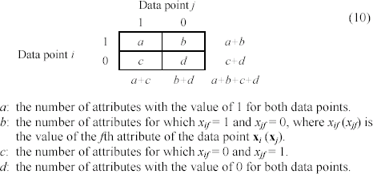
Confusion matrix

Slide 35

Contd..
🞄 Cosine similarity
𝑥. 𝑦
cos 𝑥, 𝑦
⁼ 𝑥 . 𝑦
🞄 Euclidean distance
𝑑 𝑥, 𝑦
= ∑ 𝑥_{𝑖} − 𝑦_{𝑖} ²
🞄 Minkowski Metric

Slide 36
2. Stopping criteria
no (or minimum) re-assignments of data points to different clusters,
no (or minimum) change of centroids, or
minimum decrease in the sum of squared error (SSE),
k
SSE = ∑∑
dist(x,m _{j} )²
x∈C _{j}
j =1
🞄 C_{i} is the jth cluster, m_{j} is the centroid of cluster C_{j} (the mean vector of all the data points in C_{j}), and dist(x, m_{j}) is the distance between data point x and centroid m_{j}.

Slide 37
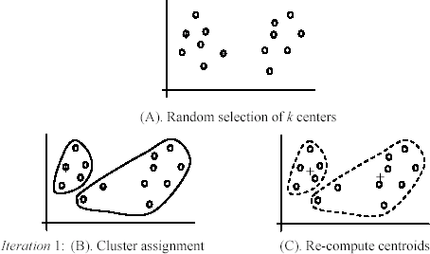
An example
+
+

Slide 38
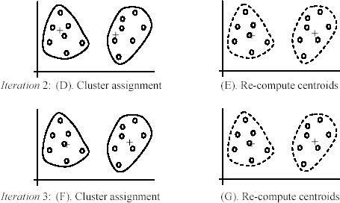
An example (cont …)

Slide 39


3. Cluster quality
🞄 Intra-cluster cohesion (compactness):
🞄 Cohesion measures how near the data points in a cluster are to the cluster centroid.
🞄 Sum of squared error (SSE) is a commonly used measure.
🞄 Inter-cluster separation (isolation):
🞄 Separation means that different cluster centroids should be far away from one another.
a
b
Dimension 1
Dimension 2

Slide 40
Content
🞄 Motivation
🞄 Introduction
🞄 Applications
🞄 Types of clustering
🞄 Clustering criterion functions
🞄 Distance functions
🞄 Normalization
🞄 Which clustering algorithm to use?
🞄 Cluster evaluation
🞄 Summary

Slide 41
Normalization
🞄 Technique to force the attributes to have a common value range
🞄 What is the need ?
🞄 Consider the following pair of data points
x_{i}: (0.1, 20) and x_{j}: (0.9, 720).
dist(x_{i} , x _{j} ) = (0.9 − 0.1)² + (720− 20)² = 700.000457,
🞄 Two main approaches to standardize interval scaled attributes, range and z-score. f is an attribute
^{x}if
min( f )
range(x ) =
,
if
max( f ) − min( f )

Slide 42
Contd..
🞄 Z-score: transforms the attribute values so that they have a mean of zero and a mean absolute deviation of 1. The mean absolute deviation of attribute f, denoted by s_{f}, is computed as follows
m = ¹ (x + x + ... + x ),
f
n
1 f 2 f nf
s = ¹ (| x
− m |),
m
| + | x
− m | +...+ | x
f
n
1 f
f
2 f
f
nf
f
x − m_{f .}
Z-score:
z(x ) =
if
if
s
f

Slide 43
Content
🞄 Motivation
🞄 Introduction
🞄 Applications
🞄 Types of clustering
🞄 Clustering criterion functions
🞄 Distance functions
🞄 Normalization
🞄 Which clustering algorithm to use?
🞄 Cluster evaluation
🞄 Summary

Slide 44
How to choose a clustering algorithm
🞄 A vast collection of algorithms are available. Which one to choose for our problem ?
🞄 Choosing the “best” algorithm is a challenge.
🞄 Every algorithm has limitations and works well with certain data distributions.
🞄 It is very hard, if not impossible, to know what distribution the application data follow. The data may not fully follow any “ideal” structure or distribution required by the algorithms.
🞄 One also needs to decide how to standardize the data, to choose a suitable distance function and to select other parameter values.

Slide 45
Contd..
🞄 Due to these complexities, the common practice is to
🞄 run several algorithms using different distance functions and parameter settings, and
🞄 then carefully analyze and compare the results.
🞄 The interpretation of the results must be based on insight into the meaning of the original data together with knowledge of the algorithms used.
🞄 Clustering is highly application dependent and to certain extent subjective (personal preferences).

Slide 46
Content
🞄 Motivation
🞄 Introduction
🞄 Applications
🞄 Types of clustering
🞄 Clustering criterion functions
🞄 Distance functions
🞄 Normalization
🞄 Which clustering algorithm to use?
🞄 Cluster evaluation
🞄 Summary

Slide 47
Cluster Evaluation: hard problem
🞄 The quality of a clustering is very hard to evaluate because
🞄 We do not know the correct clusters
🞄 Some methods are used:
🞄 User inspection
🞄 Study centroids, and spreads
🞄 Rules from a decision tree.
🞄 For text documents, one can read some documents in clusters.

Slide 48
Cluster evaluation: ground truth
🞄 We use some labeled data (for classification)
🞄 Assumption: Each class is a cluster.
🞄 After clustering, a confusion matrix is constructed. From the matrix, we compute various measurements, entropy, purity, precision, recall and F-score.
🞄 Let the classes in the data D be C = (c₁, c₂, …, c_{k}). The clustering method produces k clusters, which divides D into k disjoint subsets, D₁, D₂, …, D_{k}.

Slide 49
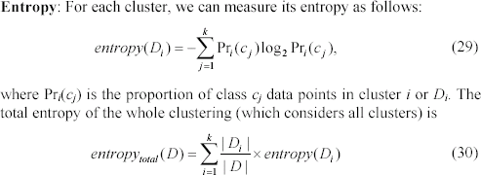
Evaluation measures: Entropy

Slide 50
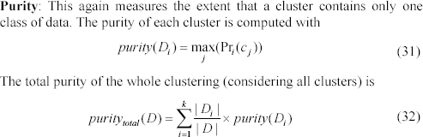
Evaluation measures: purity

Slide 51
Indirect evaluation
🞄 In some applications, clustering is not the primary task, but used to help perform another task.
🞄 We can use the performance on the primary task to compare clustering methods.
🞄 For instance, in an application, the primary task is to provide recommendations on book purchasing to online shoppers.
🞄 If we can cluster books according to their features, we might be able to
provide better recommendations.
🞄 We can evaluate different clustering algorithms based on how well they help with the recommendation task.
🞄 Here, we assume that the recommendation can be reliably evaluated.

Slide 52
Content
🞄 Motivation
🞄 Introduction
🞄 Applications
🞄 Types of clustering
🞄 Clustering criterion functions
🞄 Distance functions
🞄 Normalization
🞄 Which clustering algorithm to use?
🞄 Cluster evaluation
🞄 Summary

Slide 53
Summary
🞄 Studied need for unsupervised learning
🞄 Types of clustering:
🞄 K-means, Fuzzy C, hierarchical
🞄 Similarity functions:
🞄 Euclidean distance, Manhattan distance
🞄 Stopping criteria:
🞄 SSD
🞄 Which algorithm to choose ?
🞄 Cluster evaluation

Slide 54
Thank you

